Slide 1
Sitecore 9 Forms
Drag & drop awesomeness

Slide 2

Who am I?
Sitecore dev @ Endava
Email: Andrei.Avram@endava.com
Skype: avr.andrei
Twitter: @AvrAndrei

Slide 3

A little bit of history…

Slide 4

WFFM – Is it dead?
Is it dead?

Slide 5
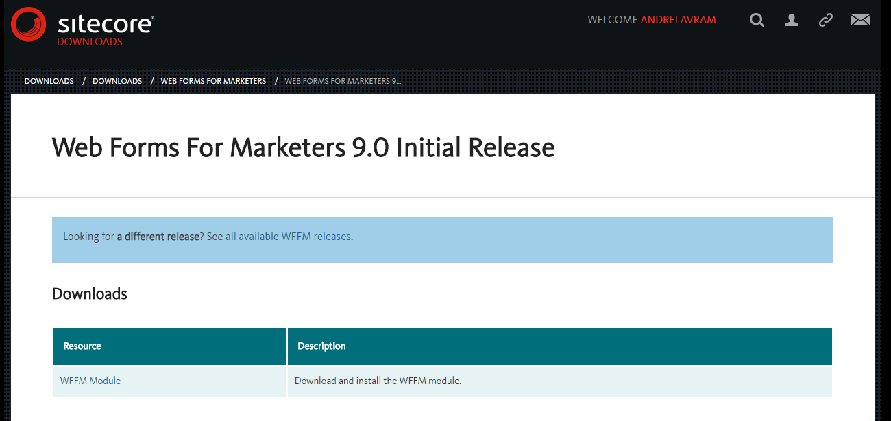
WFFM – Not Quite
WFFM 9.0!!!
No auto-upgrade path to the new Forms

Slide 6
The new Forms
OOTB → no more module to install. Yaay!
Create & edit forms by drag & drop
Create forms from templates
Form validation
BYOS (Bring Your Own Styling)
Get data saving OOTB
Get insights on how the form is performing

Slide 7
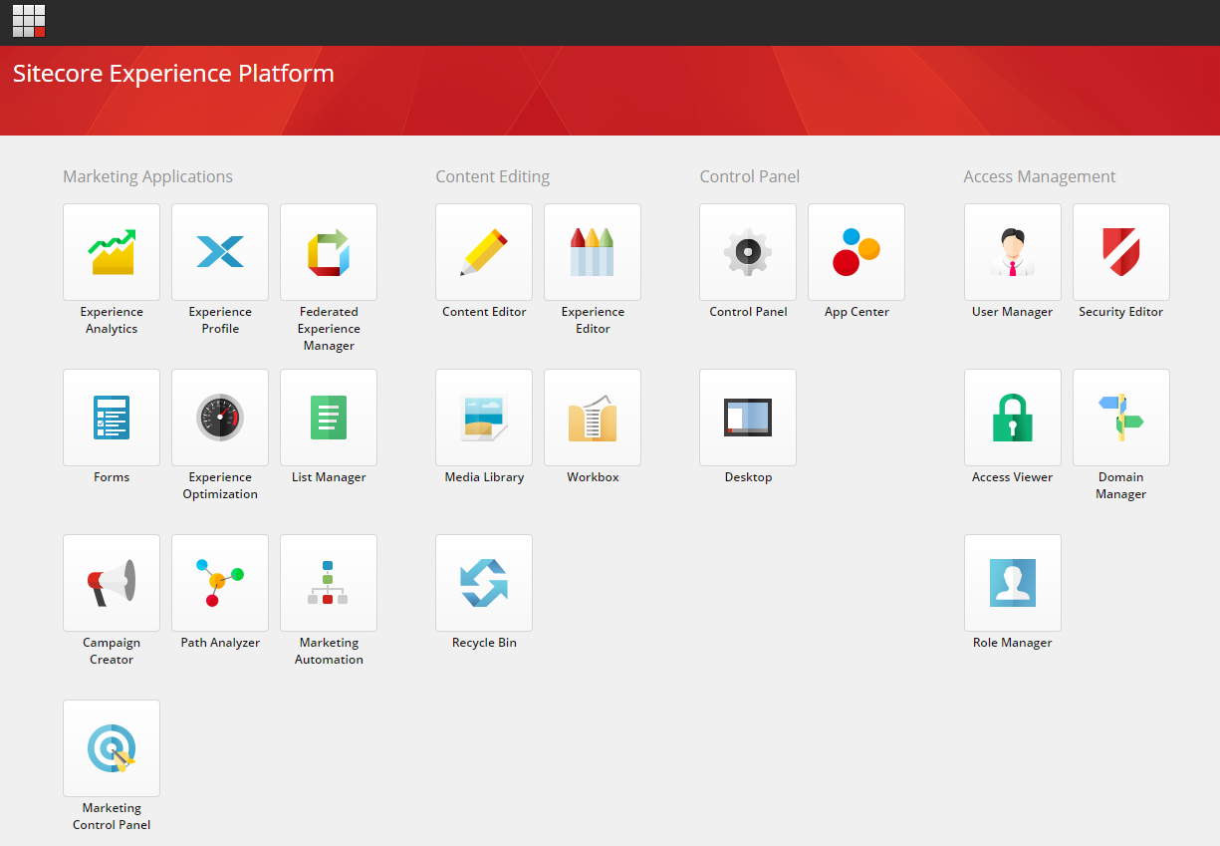
The new Forms – Where is it?

Slide 8
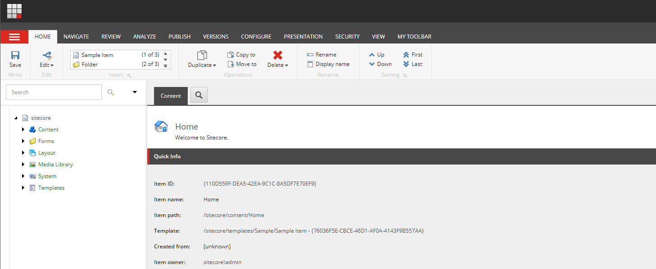
The new Forms – Where is it?

Slide 9
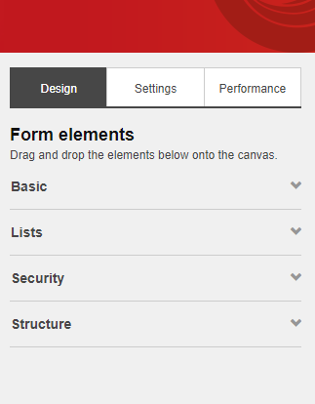
The new Forms – Building Blocks

Slide 10
The new Forms - Structure
Sections
Custom Styling
Multipage forms!!!

Slide 11
The new forms – Extensibility Points
Add new field types
Add new validations
Add new submit actions

Slide 12
Questions?
https://sitecore.stackexchange.com
https://doc.sitecore.net/sitecore_experience_platform/digital_marketing/sitecore_forms

